Slide 1
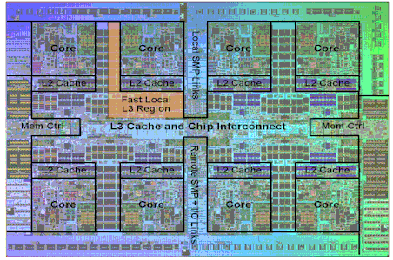


Memory
IBM Power 7
Taj Mahal
GMU CS695
Advanced Computer Architecture
Spring 2023
Lishan Yang
Notes:
http://netmgt.blogspot.com/2010/02/ibm-power-7-and-edram-cache.html

Slide 2

GMU CS695 Advanced Computer Architecture
Spring 2023
Lecture 3
Memory
Reference:
CMPE 140, Hyeran Jeon
CMPE 140, Donald Hung
CMPE 140, Haonan Wang
Computer Architecture: A Quantitative Approach
Licensed for use under a Creative Commons Attribution-NonCommercial-ShareAlike 3.0 Unported License.
Lishan Yang

Slide 3
Computer Architecture Overview
Software/Applications
Operating System
Compiler
Firmware
Instruction Set
Architecture
Processor
Registers
Cache
Memory
Memory Hierarchy
HDD/SSD

Slide 4
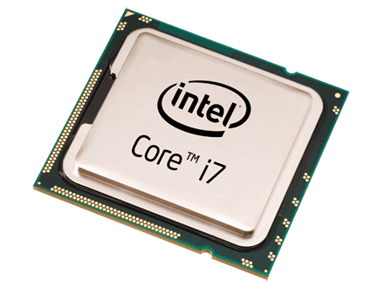
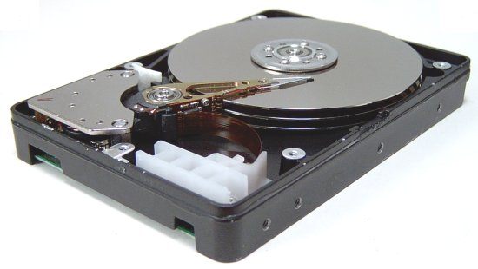
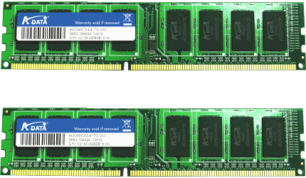
Memory Hierarchy
Example: a C program that reads
two integer values from “file.txt” file
and prints the sum of them.
Processor
(CPU)
Understands and executes each line of the code.
Uses fast on-chip memories
Memory
(DRAM)
Provides operands to CPU
(*fp, size, sum, numbers[2])
Storage
(HDD)
Provides file inputs and program code
(file.txt)
#include <stdio.h>
#include <string.h>
int numbers[2];
void myfunction(void)
{
FILE *fp;
int size = 2;
int sum = 0;
/* Open file for reading */
fp = fopen(“mynumbers.txt", “r");
/* Read and display data */
fread(numbers, sizeof(int), size, fp);
fclose(fp);
sum = numbers[0] + numbers[1];
printf(“Sum = %d\n”, sum);
}
int main (void) {
myfunction();
return(0);
}

Slide 5
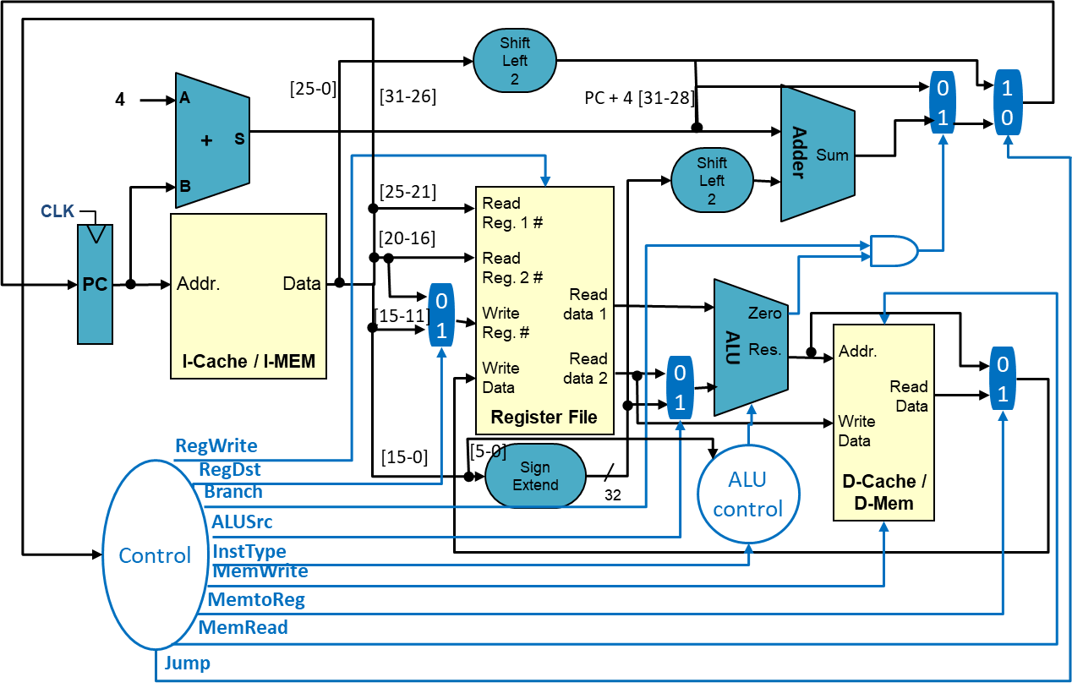
Memory Hierarchy
On-chip Memories (Memories inside of CPU)
Register file, Caches
Small but Fast
CPU
Instruction
Cache
Data
Cache
Register File

Slide 6
Memory Hierarchy
Off-chip Memories (Memories outside CPU)
System Memory, Storage
Large but Slow
CPU
System Memory
Storage

Slide 7
Memory Hierarchy
Hardware managed
1 block = multiple words
Software managed
1 register = 1 word
Access
Speed
Price/unit
Processor
Fast
Expensive
Registers
On-chip:
Subset of memory
0.5ns ~ 2.5ns
$2000 ~ $5000 per GB
Cache
Volatile Memory
50ns ~ 200ns
$20 ~ $75 per GB
Memory
Off-chip:
full memory
5ms ~ 20ms
$0.2 ~ $2 per GB
HDD/SSD
Non-volatile Memory
(NVM)
Slow
Cheap

Slide 8
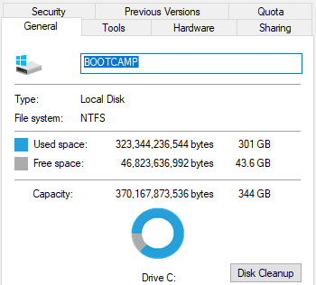
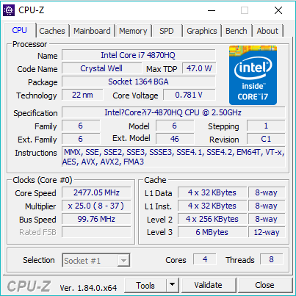
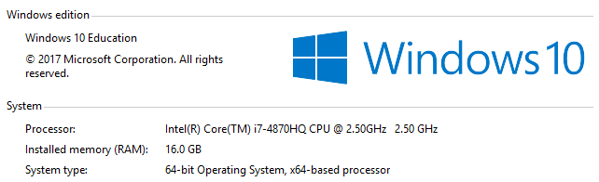
Memories in Your PC
Windows
This PC → Properties
cmd window → wmic
3rd party tool like CPU-Z
Linux
lscpu
cat /proc/cpuinfo
etc.
Storage
Caches
System Memory

Slide 9
Why?
Two Types of Locality:
Temporal Locality (Locality in Time): If an address is referenced, it tends to be referenced again (e.g., loops, variable reuse)
Spatial Locality (Locality in Space): If an address is referenced, neighboring addresses tend to be referenced (e.g., array, stack, etc.)
On-chip
Off-chip

Slide 10
The “Memory Wall”
CPU ~55%/year
(2X/1.5yr)
“Moore’s Law”
Processor-Memory
Performance Gap (grows 50%/year)
DRAM
7%/year
(2X/10yrs)

Slide 11
The Memory Hierarchy Goal
How do we create a memory system that gives the illusion of being large, cheap and fast (most of the time)?
With hierarchy
try the fast parts first -- most of the time, this works well
if not, move the data so it works well the next time
With parallelism
use multiple identical parts operating simultaneously
for large quantities of data, this works well
Example – keep a subset of the data in fast memory
Example – 1-byte-wide memory ➔ 4 × 1-byte-wide memory ➔ 4-byte-wide memory
load word takes 4 memory cycles vs. 1 memory cycle

Slide 12
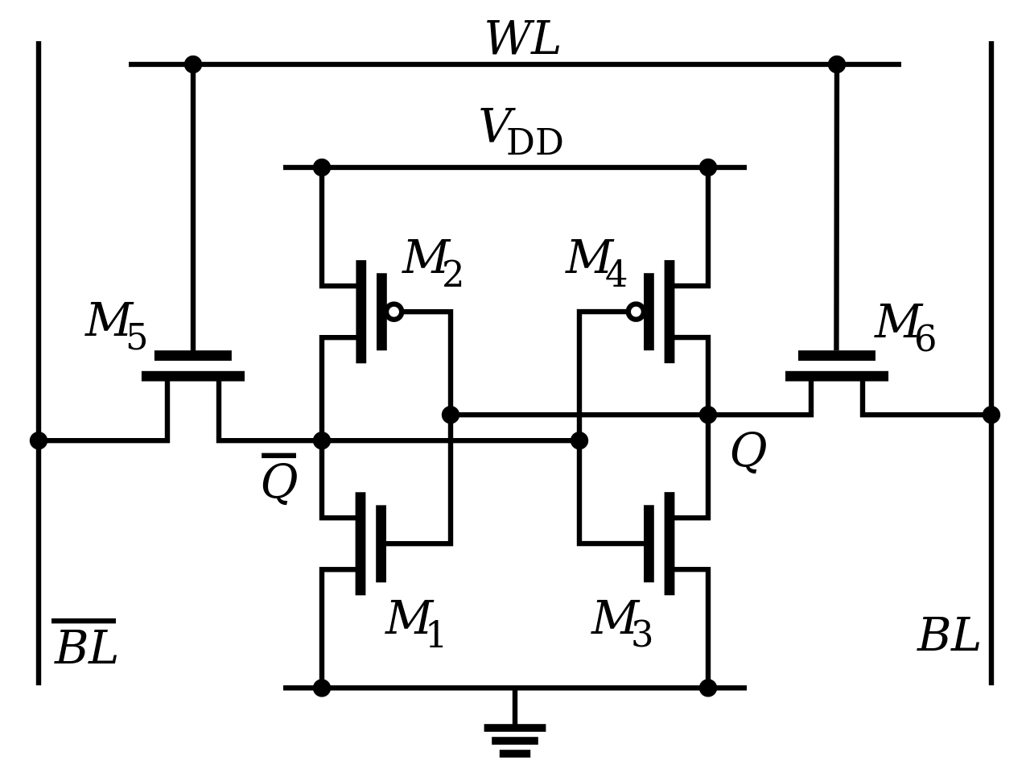
Cache Design
Caches use SRAM for speed and technology compatibility
Low density (6 transistor cells), high power, expensive, fast
Static: content will last “forever” (until power turned off)
Example: A (2M X 16 bit) SRAM logic
https://en.wikipedia.org/wiki/Static_random-access_memory#/media/File:SRAM_Cell_(6_Transistors).svg
21
Address
Chip select
SRAM
2M x 16
16
Output enable
Dout[15-0]
Write enable
Din[15-0]
16
> Read more:
https://en.wikipedia.org/wiki/Static_random-access_memory

Slide 13
SRAM Cache Design
Each row holds a data block
Column address selects the requested word from block
bit (data) lines
r
o
w
d
e
c
o
d
e
r
word (row)
select line
SRAM Cell
Array
Each intersection represents a
6-T SRAM cell
Column Selector &
I/O Circuits
column
address
row
address
4-bit data word

Slide 14
Cache Hit and Miss
Hit: Data appears in some block of the cache
Hit Rate: # hits / total accesses on the cache
Hit Time: Time to access the cache
Miss: Data needs to be retrieved from the lower level (and stored in cache)
Miss Rate: 1 - (Hit Rate)
Miss Penalty: Average delay in the processor caused by each miss
Miss
Lower Level Memory
(cache/main memory)
Cache
Can’t find!
read
read
From Processor
data block X
data block Y
Hit
Hit
To Processor

Slide 15
Memory Hierarchy Performance
Average Memory Access Time (AMAT)
= Hit Time + Miss rate x Miss Penalty
Example:
Cache Hit = 1 cycle
Miss rate = 10% = 0.1
Miss penalty = 300 cycles
AMAT = T_{hit}(L1) + Miss_rate(L1) x T(Memory) = 1 + 0.1 x 300 = 31 cycles
Due to long-latency memory, AMAT is 30 cycles longer than cache latency.
Can we reduce the overhead?
1 cycle
300 cycles
First-level
Cache
Hit Time
Miss penalty
Main
Memory
(DRAM)

Slide 16
Reducing Penalty: Multi-Level Cache
1 cycle
10 cycles
Second
Level
Cache
20 cycles
300 cycles
First-level
Cache
Third
Level
Cache
Hit Time
Main
Memory
(DRAM)
L1
L2
On Processor Die
L3
Off-Chip

Slide 17
Reducing Penalty: Multi-Level Cache
1 cycle
10 cycles
Second
Level
Cache
20 cycles
300 cycles
First-level
Cache
Third
Level
Cache
Hit Time
Main
Memory
(DRAM)
L1
L2
On Processor Die
L3
Off-Chip
AMAT in multi-level cache organization
= T_{hit}(L1) + Miss_rate(L1) x Miss_penalty(L1)

Slide 18
Reducing Penalty: Multi-Level Cache
1 cycle
10 cycles
Second
Level
Cache
20 cycles
300 cycles
First-level
Cache
Third
Level
Cache
Hit Time
Main
Memory
(DRAM)
L1
L2
On Processor Die
L3
Off-Chip
AMAT in multi-level cache organization
= T_{hit}(L1) + Miss_rate(L1) x
[ T_{hit}(L2) + Miss_rate(L2) x Miss_penalty(L2) ]

Slide 19
Reducing Penalty: Multi-Level Cache
1 cycle
10 cycles
Second
Level
Cache
20 cycles
300 cycles
First-level
Cache
Third
Level
Cache
Hit Time
Main
Memory
(DRAM)
L1
L2
On Processor Die
L3
Off-Chip
AMAT in multi-level cache organization
= T_{hit}(L1) + Miss_rate(L1) x
[ T_{hit}(L2) + Miss_rate(L2) x
{ T_{hit}(L3) + Miss_rate(L3) x Miss_penalty(L3) } ]

Slide 20
Reducing Penalty: Multi-Level Cache
1 cycle
10 cycles
Second
Level
Cache
20 cycles
300 cycles
First-level
Cache
Third
Level
Cache
Hit Time
Main
Memory
(DRAM)
L1
L2
On Processor Die
L3
Off-Chip
AMAT in multi-level cache organization
= T_{hit}(L1) + Miss_rate(L1) x
[ T_{hit}(L2) + Miss_rate(L2) x
{ T_{hit}(L3) + Miss_rate(L3) x T(memory) } ]

Slide 21
Reducing Penalty: Multi-Level Cache
1 cycle
10 cycles
Second
Level
Cache
20 cycles
300 cycles
First-level
Cache
Third
Level
Cache
Hit Time
Main
Memory
(DRAM)
L1
L2
On Processor Die
L3
AMAT in multi-level cache organization
= T_{hit}(L1) + Miss_rate(L1) x
[ T_{hit}(L2) + Miss_rate(L2) x
{ T_{hit}(L3) + Miss_rate(L3) x T(memory) } ]
Example:
Miss rate of L1, L2, L3 = 10%, 5%, 1%, respectively
AMAT = 1 + 0.1 x [ 10 + 0.05 x { 20 + 0.01 x 300 } ] = 2.115 cycles
Are more levels always good?
Off-Chip
Vs. 31 cycles
14.7x speedup!

Slide 22
Discussion
Background: The cache space is limited. We can only keep a subset of data in cache.
Question: What happens when the cache is full?
Question: What to keep in the cache (which block should be evicted)?

Slide 23
What to Keep in Caches?
It depends on the cache organization and replacing policy.
Cache organization:
Cache line (block): The basic unit of data replacement. A longer cache line fetches and replaces more data per miss.
Set: An entry that one cache line is mapped to according to certain bits of its address.
Way: A slot within a cache set to hold one history cache line.
Way 0
Way 1
…
Set 0
block 0
block 2
Set 1
block 1
block 3
…

Slide 24
What to Keep in Caches?
It depends on the cache organization and replacing policy
Cache line replacing policy: which history line should be replaced?
In a set entry, each cache line can be identified with a Tag (a portion of its address).
Least recently used (LRU), First-in first-out (FIFO), Random, etc.
Used for tag compare
Selects the set
Selects the word in the block
Address decoding:
Tag
Index
Block offset
Byte offset
Cache line:
Valid
Tag
History bits
Data (e.g., 64 Bytes)

Slide 25
Cache Indexing
Example: a simple 2-set x 2-way cache
Way 0
Way 1
Set 0
block 0
block 2
Set 1
block 1
block 3
Address decoding:
Used for tag compare
Selects the set
Selects the word in the block
Tag
Index
Block offset
Byte offset

Slide 26
Cache Types
N-way Set-Associative: Number of ways > 1 & Number of sets > 1
Slightly complex searching mechanism
Direct Mapped: Number of ways = 1
Fast indexing mechanism
Fully-Associative: Number of sets = 1
Extensive hardware resources required to search
Way 0
Way 1
…
Set 0
block 0
block 2
Set 1
block 1
block 3
…
Used for tag compare
Selects the set
Selects the word in the block
Tag
Index
Block offset
Byte offset
Assuming fixed sized cache:
Increasing associativity
Decreasing associativity
Fully associative (only one set)
Direct mapped (only one way)

Slide 27
MIPS Direct Mapped Cache Example
32bit address from the PC (Instr Fetch) or ALU (load, store addr)
Byte offset
31 30 . . . 13 12 11 . . . 2 1 0
Hit
Tag
20
10
Data
Index
Index
Valid
Tag
Data
0
1
2
.
.
.
1021
1022
1023
20
32

Slide 28
Multiword Block Direct Mapped Cache
Byte offset
Hit
31 30 . . . 13 12 11 . . . 4 3 2 1 0
Data
Tag
20
8
Block offset
Index
Index
Valid
Tag
Data
0
1
2
.
.
.
253
254
255
20
32

Slide 29
Four-Way Set Associative Cache
31 30 . . . 11 10 9 . . . 2 1 0
Byte offset
Tag
22
8
Index
Index
V
Tag
Data
V
Tag
Data
V
Tag
Data
V
Tag
Data
0
1
2
.
.
.
253
254
255
0
1
2
.
.
.
253
254
255
0
1
2
.
.
.
253
254
255
0
1
2
.
.
.
253
254
255
32
4x1 select
Hit
Data

Slide 30
Costs of Set Associative Caches
Must have hardware for replacement policy
E.g., to keep track of when each way’s block was used
N-way set associative cache costs
N comparators (delay and area) & MUX delay
Data is available after Hit/Miss decision.
In a direct mapped cache, the cache block is available before the Hit/Miss decision.
Total cache line size = valid field size + tag size + block data size + data for cache policy (e.g., time stamp, modified bit, etc.)

Slide 31
Mapping Example: Direct Mapped
0 | 1 | 2 | 3 | 4 | 5 | 6 | 7
Set No.
in cache
12 % 8 = 4
0 | 1 | 2 | 3 | 4 | 5 | 6 | 7 | 8 | 9 | 10 | 11 | 12 | 13 | 14 | 15 | 16 | 17 | 18 | 19 | 20 | 21 | 22 | 23 | 24
Block No.
in memory

Slide 32
Mapping Example: Direct Mapped
0 | 1 | 2 | 3 | 4 | 5 | 6 | 7
Set No.
in cache
0 | 1 | 2 | 3 | 4 | 5 | 6 | 7 | 8 | 9 | 10 | 11 | 12 | 13 | 14 | 15 | 16 | 17 | 18 | 19 | 20 | 21 | 22 | 23 | 24
Block No.
in memory
32

Slide 33
Mapping Example: 2-way
0 |  | 1 |  | 2 |  | 3
Set No.
in cache
12 % 4 = 0
(can go anywhere in set 0)
0 | 1 | 2 | 3 | 4 | 5 | 6 | 7 | 8 | 9 | 10 | 11 | 12 | 13 | 14 | 15 | 16 | 17 | 18 | 19 | 20 | 21 | 22 | 23 | 24
Block No.
in memory

Slide 34
Mapping Example: 2-way
0 |  | 1 |  | 2 |  | 3
Set No.
in cache
0 | 1 | 2 | 3 | 4 | 5 | 6 | 7 | 8 | 9 | 10 | 11 | 12 | 13 | 14 | 15 | 16 | 17 | 18 | 19 | 20 | 21 | 22 | 23 | 24
Block No.
in memory
34

Slide 35
Mapping Example: Fully-associative
0 | 1 | 2 | 3 | 4 | 5 | 6 | 7
Way No.
in cache
Can go anywhere
0 | 1 | 2 | 3 | 4 | 5 | 6 | 7 | 8 | 9 | 10 | 11 | 12 | 13 | 14 | 15 | 16 | 17 | 18 | 19 | 20 | 21 | 22 | 23 | 24
Block No.
in memory
35

Slide 36
Mapping Example: Fully-associative
0 | 1 | 2 | 3 | 4 | 5 | 6 | 7
Way No.
in cache
Can go anywhere
0 | 1 | 2 | 3 | 4 | 5 | 6 | 7 | 8 | 9 | 10 | 11 | 12 | 13 | 14 | 15 | 16 | 17 | 18 | 19 | 20 | 21 | 22 | 23 | 24
Block No.
in memory

Slide 37
Miss Example 1: Direct Mapped
Memory block access sequence: 0, 8, 0, 6, 5
CPU
Memory block 0 is not in the cache → MISS
Read 0
0 | 1 | 2 | 3
MEM[0]
Block no.
in cache
0 % 4 = 0
0 | 1 | 2 | 3 | 4 | 5 | 6 | 7 | 8 | 9 | 10 | 11 | 12 | 13 | 14 | 15 | 16 | 17 | 18 | 19 | 20 | 21 | 22 | 23 | 24
MEM[0]
MEM[5]
MEM[6]
MEM[8]
Block no.
in memory

Slide 38
Miss Example 1: Direct Mapped
Memory block access sequence: 0, 8, 0, 6, 5
CPU
Cache block 0 is not empty
Memory block 8 is not in the cache → MISS
Read 8
MEM[8]
0 | 1 | 2 | 3
MEM[0]
Block no.
in cache
Evict MEM[0] and fetch MEM[8]
8 % 4 = 0
0 | 1 | 2 | 3 | 4 | 5 | 6 | 7 | 8 | 9 | 10 | 11 | 12 | 13 | 14 | 15 | 16 | 17 | 18 | 19 | 20 | 21 | 22 | 23 | 24
MEM[0]
MEM[5]
MEM[6]
MEM[8]
Block no.
in memory

Slide 39
Miss Example 1: Direct Mapped
Memory block access sequence: 0, 8, 0, 6, 5
CPU
Cache block 0 is not empty
Memory block 0 is not in the cache AGAIN → MISS
Read 0
MEM[8]
0 | 1 | 2 | 3
MEM[0]
Block no.
in cache
Evict MEM[8] and fetch MEM[0]
0 % 4 = 0
0 | 1 | 2 | 3 | 4 | 5 | 6 | 7 | 8 | 9 | 10 | 11 | 12 | 13 | 14 | 15 | 16 | 17 | 18 | 19 | 20 | 21 | 22 | 23 | 24
MEM[0]
MEM[5]
MEM[6]
MEM[8]
Block no.
in memory

Slide 40
Miss Example 1: Direct Mapped
Memory block access sequence: 0, 8, 0, 6, 5
CPU
Memory block 6 is not in the cache → MISS
Read 6
MEM[6]
0 | 1 | 2 | 3
MEM[0]
Block no.
in cache
6 % 4 = 2
0 | 1 | 2 | 3 | 4 | 5 | 6 | 7 | 8 | 9 | 10 | 11 | 12 | 13 | 14 | 15 | 16 | 17 | 18 | 19 | 20 | 21 | 22 | 23 | 24
MEM[0]
MEM[5]
MEM[6]
MEM[8]
Block no.
in memory

Slide 41
Miss Example 1: Direct Mapped
Memory block access sequence: 0, 8, 0, 6, 5
CPU
Memory block 5 is not in the cache → MISS
Read 5
MEM[5]
MEM[6]
0 | 1 | 2 | 3
MEM[0]
Block no.
in cache
5 % 4 = 1
0 | 1 | 2 | 3 | 4 | 5 | 6 | 7 | 8 | 9 | 10 | 11 | 12 | 13 | 14 | 15 | 16 | 17 | 18 | 19 | 20 | 21 | 22 | 23 | 24
MEM[0]
MEM[5]
MEM[6]
MEM[8]
Block no.
in memory

Slide 42
Miss Example 2: Fully-associative
Memory block access sequence: 0, 8, 0, 6, 5
CPU
Memory block 0 is not in the cache → MISS
Read 0
0 | 1 | 2 | 3
MEM[0]
Block no.
in cache
0 | 1 | 2 | 3 | 4 | 5 | 6 | 7 | 8 | 9 | 10 | 11 | 12 | 13 | 14 | 15 | 16 | 17 | 18 | 19 | 20 | 21 | 22 | 23 | 24
MEM[0]
MEM[5]
MEM[6]
MEM[8]
Block no.
in memory
42

Slide 43
Miss Example 2: Fully-associative
Memory block access sequence: 0, 8, 0, 6, 5
CPU
Memory block 8 is not in the cache → MISS
Read 8
MEM[8]
0 | 1 | 2 | 3
MEM[0]
Block no.
in cache
0 | 1 | 2 | 3 | 4 | 5 | 6 | 7 | 8 | 9 | 10 | 11 | 12 | 13 | 14 | 15 | 16 | 17 | 18 | 19 | 20 | 21 | 22 | 23 | 24
MEM[0]
MEM[5]
MEM[6]
MEM[8]
Block no.
in memory
43

Slide 44
Miss Example 2: Fully-associative
Memory block access sequence: 0, 8, 0, 6, 5
CPU
Memory block 0 is in the cache → HIT
Read 0
MEM[8]
0 | 1 | 2 | 3
MEM[0]
Block no.
in cache
0 | 1 | 2 | 3 | 4 | 5 | 6 | 7 | 8 | 9 | 10 | 11 | 12 | 13 | 14 | 15 | 16 | 17 | 18 | 19 | 20 | 21 | 22 | 23 | 24
MEM[0]
MEM[5]
MEM[6]
MEM[8]
Block no.
in memory
44

Slide 45
Miss Example 2: Fully-associative
Memory block access sequence: 0, 8, 0, 6, 5
CPU
Memory block 6 is not in the cache → MISS
Read 6
MEM[8]
0 | 1 | 2 | 3
MEM[0]
MEM[6]
Block no.
in cache
0 | 1 | 2 | 3 | 4 | 5 | 6 | 7 | 8 | 9 | 10 | 11 | 12 | 13 | 14 | 15 | 16 | 17 | 18 | 19 | 20 | 21 | 22 | 23 | 24
MEM[0]
MEM[5]
MEM[6]
MEM[8]
Block no.
in memory
45

Slide 46
Miss Example 2: Fully-associative
Memory block access sequence: 0, 8, 0, 6, 5
CPU
Memory block 5 is not in the cache → MISS
Read 5
MEM[8]
0 | 1 | 2 | 3
MEM[0]
MEM[6]
MEM[5]
Block no.
in cache
0 | 1 | 2 | 3 | 4 | 5 | 6 | 7 | 8 | 9 | 10 | 11 | 12 | 13 | 14 | 15 | 16 | 17 | 18 | 19 | 20 | 21 | 22 | 23 | 24
MEM[0]
MEM[5]
MEM[6]
MEM[8]
Block no.
in memory
46

Slide 47
Miss Example 2: Fully-associative
Memory block access sequence: 0, 8, 0, 6, 5, 4
CPU
Cache is full
Memory block 4 is not in the cache → MISS
Read 4
MEM[4]
MEM[8]
0 | 1 | 2 | 3
MEM[0]
MEM[6]
MEM[5]
Block no.
in cache
Evict MEM[8] (LRU: least recently used)
and fetch MEM[4]
0 | 1 | 2 | 3 | 4 | 5 | 6 | 7 | 8 | 9 | 10 | 11 | 12 | 13 | 14 | 15 | 16 | 17 | 18 | 19 | 20 | 21 | 22 | 23 | 24
MEM[0]
MEM[4]
MEM[5]
MEM[6]
MEM[8]
Block no.
in memory
47

Slide 48
Miss Example 3: 2-way
Memory block access sequence: 0, 8, 0, 6, 5
Which data will be in the cache after accessing this sequence?
CPU
Memory block 0 is not in the cache → MISS
Read 0
0 |  | 1
MEM[0]
Set no.
in cache
0 % 2 = 0
0 | 1 | 2 | 3 | 4 | 5 | 6 | 7 | 8 | 9 | 10 | 11 | 12 | 13 | 14 | 15 | 16 | 17 | 18 | 19 | 20 | 21 | 22 | 23 | 24
MEM[0]
MEM[5]
MEM[6]
MEM[8]
Block no.
in memory
48

Slide 49
Miss Example 3: 2-way
Memory block access sequence: 0, 8, 0, 6, 5
CPU
Memory block 8 is not in the cache → MISS
Read 8
MEM[8]
0 |  | 1
MEM[0]
Set no.
in cache
8 % 2 = 0
0 | 1 | 2 | 3 | 4 | 5 | 6 | 7 | 8 | 9 | 10 | 11 | 12 | 13 | 14 | 15 | 16 | 17 | 18 | 19 | 20 | 21 | 22 | 23 | 24
MEM[0]
MEM[5]
MEM[6]
MEM[8]
Block no.
in memory
49

Slide 50
Miss Example 3: 2-way
Memory block access sequence: 0, 8, 0, 6, 5
CPU
Memory block 0 is in the cache → HIT
Read 0
MEM[8]
0 |  | 1
MEM[0]
Set no.
in cache
0 | 1 | 2 | 3 | 4 | 5 | 6 | 7 | 8 | 9 | 10 | 11 | 12 | 13 | 14 | 15 | 16 | 17 | 18 | 19 | 20 | 21 | 22 | 23 | 24
MEM[0]
MEM[5]
MEM[6]
MEM[8]
Block no.
in memory
50

Slide 51
Miss Example 3: 2-way
Memory block access sequence: 0, 8, 0, 6, 5
CPU
Cache set 0 is full
Memory block 6 is not in the cache → MISS
Read 6
MEM[6]
MEM[8]
0 |  | 1
MEM[0]
Set no.
in cache
Evict MEM[8] (least recently accessed block)
and fetch MEM[6]
6 % 2 = 0
0 | 1 | 2 | 3 | 4 | 5 | 6 | 7 | 8 | 9 | 10 | 11 | 12 | 13 | 14 | 15 | 16 | 17 | 18 | 19 | 20 | 21 | 22 | 23 | 24
MEM[0]
MEM[5]
MEM[6]
MEM[8]
Block no.
in memory
51

Slide 52
Miss Example 3: 2-way
Memory block access sequence: 0, 8, 0, 6, 5
CPU
Memory block 5 is not in the cache → MISS
Read 5
MEM[0]
MEM[6]
MEM[5]
0 |  | 1
Set no.
in cache
5 % 2 = 1
0 | 1 | 2 | 3 | 4 | 5 | 6 | 7 | 8 | 9 | 10 | 11 | 12 | 13 | 14 | 15 | 16 | 17 | 18 | 19 | 20 | 21 | 22 | 23 | 24
MEM[0]
MEM[5]
MEM[6]
MEM[8]
Block no.
in memory
52

Slide 53
Cache Miss Classification: The 3 C’s
Compulsory (cold) Misses
On the 1st reference to a block
Related to # blocks accessed by a code, not related to the configuration of a cache
Capacity Misses
The program’s working set size exceeds the cache capacity
Conflict Misses
Multiple memory blocks map to the same set in set-associative caches

Slide 54
More Detailed Mapping Example
1st step: Find data block number that the word belongs to
We have a cache that has following configuration
Consists of 8 cache blocks (lines)
A data word is 4-byte
A block is 32-byte (8 words per block)
Direct mapped
We load a word from 0x77FF1C68
cache blocks
0 | 1 | 2 | 3 | 4 | 5 | 6 | 7
Offset within a data word
0x77FF1C68 = 0111 0111 1111 1111 0001 1100 0110 1000
Block no.
Each data word’s offset
within a block
(2nd word in a block)

Slide 55
More Detailed Mapping Example
2nd step: Map the block number to cache block number
We have a cache that has following configuration
Consists of 8 cache blocks (lines)
A data word is 4-byte
A block is 32-byte (8 words per block)
Direct mapped
We load a word from 0x77FF1C68
cache blocks
0 | 1 | 2 | 3 | 4 | 5 | 6 | 7
Offset within a data word
0x77FF1C68 = 0111 0111 1111 1111 0001 1100 0110 1000
Block no.
Each data word’s offset
within a block
(2nd word in a block)
% 8 blocks
= cache block no. 3

Slide 56
More Detailed Mapping Example
1st step: Calculate how many sets exist
8 blocks / 4 entries per set = 2 sets
We have a cache that has following configuration
Consists of 8 cache blocks (lines)
A data word is 4-byte
A block is 32-byte (8 words per block)
4-way Set-Associative
We load a word from 0x77FF1C68
cache blocks
cache blocks
0 |  |  |  | 1
0 | 1 | 2 | 3 | 4 | 5 | 6 | 7
set no.

Slide 57
More Detailed Mapping Example
2nd step: Find data block number that the word belongs to
We have a cache that has following configuration
Consists of 8 cache blocks (lines)
A data word is 4-byte
A block is 32-byte (8 words per block)
4-way Set-Associative
We load a word from 0x77FF1C68
cache blocks
0 |  |  |  | 1
set no.
Offset within a data word
0x77FF1C68 = 0111 0111 1111 1111 0001 1100 0110 1000
Block no.
Each data word’s offset
within a block
(2nd word in a block)

Slide 58
More Detailed Mapping Example
3rd step: Map the block number to cache block number
pick any available block within set 1
We have a cache that has following configuration
Consists of 8 cache blocks (lines)
A data word is 4-byte
A block is 32-byte (8 words per block)
4-way Set-Associative
We load a word from 0x77FF1C68
cache blocks
0 |  |  |  | 1
set no.
Offset within a data word
0x77FF1C68 = 0111 0111 1111 1111 0001 1100 0110 1000
Block no.
Each data word’s offset
within a block
(2nd word in a block)
% 2 sets
= cache block no. 1

Slide 59
More Detailed Mapping Example
1st and all step: Find any available cache block and map
pick any available block
We have a cache that has following configuration
Consists of 8 cache blocks (lines)
A data word is 4-byte
A block is 32-byte (8 words per block)
Fully-Associative
We load a word from 0x77FF1C68
cache blocks
0 | 1 | 2 | 3 | 4 | 5 | 6 | 7

Slide 60
Cache Replacement Policy
When loading a new block (on miss), if the cache is already full, which block should be replaced (in the set)?
Random: Replace a randomly chosen line
FIFO: Replace the oldest line
LRU (Least Recently Used): Replace the least recently used line
Many others: Round Robin, LIFO, MRU, etc..

Slide 61
LRU Example
Cache configuration:
Size: 4 blocks
Mapping: fully-associative
Replacement: LRU
Mem access sequence: (each character indicates a block address)
ABCDCDECG
Accesses |  | A | B | C | D | C | D | E | C | G
priority order (LRU) | 0 (MRU) | A
 | 1
 | 2
 | 3 (LRU)
cache miss |  | m

Slide 62
LRU Example
Cache configuration:
Size: 4 blocks
Mapping: fully-associative
Replacement: LRU
Mem access sequence: (each character indicates a block address)
ABCDCDECG
Accesses |  | A | B | C | D | C | D | E | C | G
priority order (LRU) | 0 (MRU) | A | B
 | 1 |  | A
 | 2
 | 3 (LRU)
cache miss |  | m | m

Slide 63
LRU Example
Cache configuration:
Size: 4 blocks
Mapping: fully-associative
Replacement: LRU
Mem access sequence: (each character indicates a block address)
ABCDCDECG
Accesses |  | A | B | C | D | C | D | E | C | G
priority order (LRU) | 0 (MRU) | A | B | C
 | 1 |  | A | B
 | 2 |  |  | A
 | 3 (LRU)
cache miss |  | m | m | m

Slide 64
LRU Example
Cache configuration:
Size: 4 blocks
Mapping: fully-associative
Replacement: LRU
Mem access sequence: (each character indicates a block address)
ABCDCDECG
Accesses |  | A | B | C | D | C | D | E | C | G
priority order (LRU) | 0 (MRU) | A | B | C | D
 | 1 |  | A | B | C
 | 2 |  |  | A | B
 | 3 (LRU) |  |  |  | A
cache miss |  | m | m | m | m

Slide 65
LRU Example
Cache configuration:
Size: 4 blocks
Mapping: fully-associative
Replacement: LRU
Mem access sequence: (each character indicates a block address)
ABCDCDECG
Accesses |  | A | B | C | D | C | D | E | C | G
priority order (LRU) | 0 (MRU) | A | B | C | D | C
 | 1 |  | A | B | C | D
 | 2 |  |  | A | B | B
 | 3 (LRU) |  |  |  | A | A
cache miss |  | m | m | m | m | h

Slide 66
LRU Example
Cache configuration:
Size: 4 blocks
Mapping: fully-associative
Replacement: LRU
Mem access sequence: (each character indicates a block address)
ABCDCDECG
Accesses |  | A | B | C | D | C | D | E | C | G
priority order (LRU) | 0 (MRU) | A | B | C | D | C | D
 | 1 |  | A | B | C | D | C
 | 2 |  |  | A | B | B | B
 | 3 (LRU) |  |  |  | A | A | A
cache miss |  | m | m | m | m | h | h
LRU to be replaced for E

Slide 67
LRU Example
Cache configuration:
Size: 4 blocks
Mapping: fully-associative
Replacement: LRU
Mem access sequence: (each character indicates a block address)
ABCDCDECG
Accesses |  | A | B | C | D | C | D | E | C | G
priority order (LRU) | 0 (MRU) | A | B | C | D | C | D | E
 | 1 |  | A | B | C | D | C | D
 | 2 |  |  | A | B | B | B | C
 | 3 (LRU) |  |  |  | A | A | A | B
cache miss |  | m | m | m | m | h | h | m

Slide 68
LRU Example
Cache configuration:
Size: 4 blocks
Mapping: fully-associative
Replacement: LRU
Mem access sequence: (each character indicates a block address)
ABCDCDECG
Accesses |  | A | B | C | D | C | D | E | C | G
priority order (LRU) | 0 (MRU) | A | B | C | D | C | D | E | C
 | 1 |  | A | B | C | D | C | D | E
 | 2 |  |  | A | B | B | B | C | D
 | 3 (LRU) |  |  |  | A | A | A | B | B
cache miss |  | m | m | m | m | h | h | m | h
LRU to be
replaced for G

Slide 69
LRU Example
Cache configuration:
Size: 4 blocks
Mapping: fully-associative
Replacement: LRU
Mem access sequence: (each character indicates a block address)
ABCDCDECG
Accesses |  | A | B | C | D | C | D | E | C | G
priority order (LRU) | 0 (MRU) | A | B | C | D | C | D | E | C | G
 | 1 |  | A | B | C | D | C | D | E | C
 | 2 |  |  | A | B | B | B | C | D | E
 | 3 (LRU) |  |  |  | A | A | A | B | B | D
cache miss |  | m | m | m | m | h | h | m | h | m

Slide 70
Cache Policies: Cases
Allocation policy: do we allocate a block in cache for the missed data?
Read policies:
Read Hit: this is what we want. Only one data read from the cache.
Read Miss: needs to fetch from lower level, but just write to the register once after that
read-allocate (with replacement policy) vs. no-read-allocate (i.e., cache bypassing)
Write policies (only for the data cache): consistency & performance tradeoffs
Write Hit: behavior and number of writes depends on write policy
Write-through vs. write-back vs. write-evict
Write Miss: needs to first read from lower level, then apply write policies
Write-allocate (with replacement policy): Write-through vs. Write-back
No-write-allocate (bypassing): Write-evict

Slide 71
Write Policy: Write-back
Write-back: inconsistent with lower level
The value is written only to the cache line.
The modified (dirty) cache line is written to the lower level only when it is evicted.
1 dirty bit is needed for each cache line.
A write-back buffer to update lower level with evicted dirty blocks
Must write a full block at this point since we do not know which word is modified
Example: assume cache block containing word address A is initially in the cache
dirty bit (A) = 0
SW to A
dirty bit (A) = 1
A
A
A
B

Slide 72
Write Policy: Write-back
Write-back: inconsistent with lower level
The value is written only to the cache line.
The modified (dirty) cache line is written to the lower level only when it is evicted.
1 dirty bit is needed for each cache line.
A write-back buffer to update lower level with evicted dirty blocks
Must write a full block at this point since we do not know which word is modified
Example: assume cache block containing word address A is initially in the cache
LW B
dirty bit (A) = 1
If A was not modified (dirty bit = 0) when replaced, A is not updated to lower mem.
A few cycles later...
A
A
B
L1 is full and A is selected to be replaced by B

Slide 73
Write Policy: Write-through
Write-through: consistent with lower level
The value is written to both the cache line and the lower-level memory.
No need to write a full block to the lower level (e.g., only write 4B for a SW)
Write buffer can be used so cache does not need to wait for the write to lower level
stall only if the write buffer is full
Example: assume cache block containing word address A is initially in the cache
SW to A
A
A
A
A

Slide 74
Write Policy: Write-through
Write-through: consistent with lower level
The value is written to both the cache line and the lower-level memory.
No need to write a full block to the lower level (e.g., only write 4B for a SW)
Write buffer can be used so cache does not need to wait for the write to lower level
stall only if the write buffer is full
Example: assume cache block containing word address A is initially in the cache
A
A
A

Slide 75
Write Policy: Write-evict
Write-evict (no-write): no consistency issue
The value is written only to the lower level (i.e., bypassing).
No need to fetch the data first if it is missing in the cache
If the block containing the write address exists in the cache, evict it.
The write only needs to send the data specified by the store instruction (e.g., 4 Bytes).
Write buffer can be used so cache does not need to wait for the write to lower level
More expensive when there is read after write

Slide 76
Cache Miss Behavior Analysis
Read miss:
+Write-through: evict victim block + fetch block from lower level
+Write-back: evict victim block + write back evicted block if dirty + fetch block from lower level
+No-write: find victim block + fetch block from lower level
Write miss:
Write-allocate:
+Write-through: evict victim block + fetch block from lower level + store word to block + store word to lower level
+Write-back: evict victim block + write back evicted block if dirty + fetch block from lower level + store word to block
No-write-allocate: +Write-evict: store word to lower level directly

Slide 77
Other Cache Policy details
Some caches support multiple policies
Can achieve different delay/bandwidth tradeoffs or even dynamically change
Write hit and write miss can use different policies
E.g., write-hit write-evict + write-miss write-allocate-write-back
Different cache levels can also use different policies
E.g., L1 use write-evict + L2 use write-back
Cache can also be completely bypassed (not the same as write-evict)
E.g., bypassing L1

Slide 78
Reduce Miss Rate (1): Code Optimization
Misses occur if sequentially accessed array elements come from different cache blocks
Code optimizations → No hardware change
Rely on programmers or compilers
Examples:
Loop interchange: In nested loops, outer loop becomes inner loop and vice versa
Loop blocking: partition large array into smaller blocks, thus fitting the accessed array elements into cache size

Slide 79
Loop Interchange
Assume: cache line size = 5 words
What addresses are accessed in each iteration of inner loop?
five consecutive words belong to a cache line
j
i
each loop iteration accesses different cache line
/* Before */
for (j=0; j<5; j++)
for (i=0; i<5; i++)
x[i][j] = 2*x[i][j]
Column-major ordering
j
Row-major ordering
i
The same cache line is accessed for a couple of iterations
/* After */
for (i=0; i<5; i++)
for (j=0; j<5; j++)
x[i][j] = 2*x[i][j]

Slide 80
Loop Blocking
In the traditional matrix multiplication:
/* Before */
for (i=0; i<N; i++)
for (j=0; j<N; j++)
for (k=0; k<N; k++)
C[i][j] = C[i][j] + A[i][k] * B[k][j];
X
=
To generate one output element (red color), the 6 elements of each input matrix (gray color) will be accessed.

Slide 81
Loop Blocking
In the traditional matrix multiplication:
/* Before */
for (i=0; i<N; i++)
for (j=0; j<N; j++)
for (k=0; k<N; k++)
C[i][j] = C[i][j] + A[i][k] * B[k][j];
X
=
To generate one output element (red color), the 6 elements of each input matrix (gray color) will be accessed.

Slide 82
Loop Blocking
In the traditional matrix multiplication:
/* Before */
for (i=0; i<N; i++)
for (j=0; j<N; j++)
for (k=0; k<N; k++)
C[i][j] = C[i][j] + A[i][k] * B[k][j];
X
=
To generate one output element (red color), the 6 elements of each input matrix (gray color) will be accessed.

Slide 83
Loop Blocking
In the traditional matrix multiplication:
/* Before */
for (i=0; i<N; i++)
for (j=0; j<N; j++)
for (k=0; k<N; k++)
C[i][j] = C[i][j] + A[i][k] * B[k][j];
X
=
To generate one output element (red color), the 6 elements of each input matrix (gray color) will be accessed.

Slide 84
Loop Blocking
In the traditional matrix multiplication:
/* Before */
for (i=0; i<N; i++)
for (j=0; j<N; j++)
for (k=0; k<N; k++)
C[i][j] = C[i][j] + A[i][k] * B[k][j];
X
=
To generate one output element (red color), the 6 elements of each input matrix (gray color) will be accessed.

Slide 85
Loop Blocking
In the traditional matrix multiplication:
The second matrix may always encounter misses because individual data are from different cache blocks
/* Before */
for (i=0; i<N; i++)
for (j=0; j<N; j++)
for (k=0; k<N; k++)
C[i][j] = C[i][j] + A[i][k] * B[k][j];
X
=
To generate one output element (red color), the 6 elements of each input matrix (gray color) will be accessed.

Slide 86
Loop Blocking
In the traditional matrix multiplication:
If N is large, the cache line that has been accessed is likely to be replaced before next access
/* Before */
for (i=0; i<N; i++)
for (j=0; j<N; j++)
for (k=0; k<N; k++)
C[i][j] = C[i][j] + A[i][k] * B[k][j];
X
=
To generate one output element (red color), the 6 elements of each input matrix (gray color) will be accessed.

Slide 87
Loop Blocking
In the block-based matrix multiplication:
/* After (block size = 4) */
for (i=0; i<N; i=i+b)
for (j=0; j<N; j=j+b)
for (k=0; k<N; k=k+b)
for (ii=i; ii<i+b; ii++)
for (jj=j; jj<j+b; jj++)
for (kk=k; kk<k+b; kk++)
C[ii][jj] = C[ii][jj] + A[ii][kk] * B[kk][jj];
Matrix is computed in a smaller block unit
→ higher locality
X
=

Slide 88
Loop Blocking
In the block-based matrix multiplication:
/* After (block size = 4) */
for (i=0; i<N; i=i+b)
for (j=0; j<N; j=j+b)
for (k=0; k<N; k=k+b)
for (ii=i; ii<i+b; ii++)
for (jj=j; jj<j+b; jj++)
for (kk=k; kk<k+b; kk++)
C[ii][jj] = C[ii][jj] + A[ii][kk] * B[kk][jj];
X
=

Slide 89
Loop Blocking
In the block-based matrix multiplication:
/* After (block size = 4) */
for (i=0; i<N; i=i+b)
for (j=0; j<N; j=j+b)
for (k=0; k<N; k=k+b)
for (ii=i; ii<i+b; ii++)
for (jj=j; jj<j+b; jj++)
for (kk=k; kk<k+b; kk++)
C[ii][jj] = C[ii][jj] + A[ii][kk] * B[kk][jj];
X
=

Slide 90
Loop Blocking
In the block-based matrix multiplication:
/* After (block size = 4) */
for (i=0; i<N; i=i+b)
for (j=0; j<N; j=j+b)
for (k=0; k<N; k=k+b)
for (ii=i; ii<i+b; ii++)
for (jj=j; jj<j+b; jj++)
for (kk=k; kk<k+b; kk++)
C[ii][jj] = C[ii][jj] + A[ii][kk] * B[kk][jj];
X
=

Slide 91
Loop Blocking
In the block-based matrix multiplication:
/* After (block size = 4) */
for (i=0; i<N; i=i+b)
for (j=0; j<N; j=j+b)
for (k=0; k<N; k=k+b)
for (ii=i; ii<i+b; ii++)
for (jj=j; jj<j+b; jj++)
for (kk=k; kk<k+b; kk++)
C[ii][jj] = C[ii][jj] + A[ii][kk] * B[kk][jj];
X
=

Slide 92
Loop Blocking
In the block-based matrix multiplication:
/* After (block size = 4) */
for (i=0; i<N; i=i+b)
for (j=0; j<N; j=j+b)
for (k=0; k<N; k=k+b)
for (ii=i; ii<i+b; ii++)
for (jj=j; jj<j+b; jj++)
for (kk=k; kk<k+b; kk++)
C[ii][jj] = C[ii][jj] + A[ii][kk] * B[kk][jj];
X
=

Slide 93
Loop Blocking
In the block-based matrix multiplication:
/* After (block size = 4) */
for (i=0; i<N; i=i+b)
for (j=0; j<N; j=j+b)
for (k=0; k<N; k=k+b)
for (ii=i; ii<i+b; ii++)
for (jj=j; jj<j+b; jj++)
for (kk=k; kk<k+b; kk++)
C[ii][jj] = C[ii][jj] + A[ii][kk] * B[kk][jj];
X
=

Slide 94
Reduce Miss Rate (2): Reduce the 3 C’s
Compulsory (cold) Misses
Capacity Misses
Conflict Misses
Increase Cache Size
Reduce miss for: capacity miss, conflict miss
But has many limitations
Increase Associativity (cache size unchanged)
Reduce miss for: conflict miss
But may increase access latency
Increase Cache Block Size (cache size unchanged)
Reduce miss for: compulsory
But may increase miss penalty (more data will be evicted and fetched)
Very large blocks could increase miss rate (i.e., increase capacity miss)

Slide 95
Miss Rate vs Block Size vs Cache Size
Cache size – the larger the better
Block size – tradeoffs
Why?

Slide 96
Block Size Tradeoff
Average
Access
Time
Miss
Rate
Miss
Penalty
Exploits Spatial Locality
Increased Miss Penalty
& Miss Rate
Fewer blocks -- increases capacity misses
Block Size
Block Size
Block Size
Average Memory Access Time = Hit Time + Miss Penalty x Miss Rate

Slide 97
Benefits of Set Associative Caches
Largest gains when going from direct mapped to 2-way (20%+ reduction in miss rate)
Data from Hennessy & Patterson, Computer Architecture

Slide 98
Reduce Miss Rate (3): Policies
Use appropriate policies
LRU + write-back works for most applications
Many GPUs use write-hit write-evict + write-miss no-write-allocate
Can even dynamically change policy according to profiling
Use more advanced policies
E.g., ML based

Slide 99
Reduce Miss Rate (4): Multi-level Caches
Having a unified L2 cache (i.e., it holds both instructions and data) and in some cases even a unified L3 cache
L1 cache should focus on minimizing hit time in support of a shorter clock cycle
Secondary cache(s) should focus on reducing miss rate to reduce the penalty of long main memory access times

Slide 100
Split vs. Unified Caches
Split L1I$ and L1D$: to optimize t_{hit}
Low capacity/associativity/block size (reduce t_{hit})
Minimize structural hazards
Can optimize L1I$ for wide output and no writes
Unified L2: to optimize hit rate
t_{hit} is less important due to less frequent accesses & long delay already
High capacity/associativity/block size (reduce %_{miss})
Unused instr capacity can be used for data (fewer capacity misses)
Instr / data conflicts (small to no increase for conflict misses in a large cache)
Instr / data structural hazards are rare (would take a simultaneous L1I$ and L1D$ miss)

Slide 101
Reduce Miss Rate (5): Prefetching
Hardware prefetching
Fetch blocks into the cache proactively (speculatively)
Key is to anticipate the upcoming miss addresses accurately
Relies on having unused memory bandwidth available
A simple case is to use next block prefetching
Miss on address X → anticipate next reference miss on X + block-size
Works well for instructions (sequential execution) and for arrays of data
Need to initiate prefetches sufficiently in advance
If prefetched instruction/data is not used, the cache is polluted with unnecessary data (possibly evicting useful data)

Slide 102
Measuring Performance with Caches
Assuming cache hit costs are included as part of the normal CPU execution cycle, then
CPU time = IC × CPI × CP
= IC × (CPI_{ideal} + Memory-stall cycles) × CP
CPI_{stall}
Note: this is miss ratio with regard to all instructions (not only LW)
= read ratio * cache miss rate
Memory-stall cycles come from cache misses (a sum of read-stalls and write-stalls)
Read-stall cycles = read miss ratio × read miss penalty
Write-stall cycles = write miss ratio × write miss penalty + write buffer stalls
For write-through caches, we can simplify this to
Memory-stall cycles = miss ratio × miss penalty

Slide 103
Measuring Performance with Caches
Example: A processor with a CPI_{ideal} of 2, a 100 cycle miss penalty, 36% load/store instructions, and 2% I$ and 4% D$ miss rates
Memory-stall cycles = 2% × 100 + 36% × 4% × 100 = 3.44
CPI_{stalls} = 2 + 3.44 = 5.44

Slide 104
Other than Miss Rates
Cache bypassing (e.g., L1D)
Reduce latency if L1 misses
Sector cache
Fetch only a portion of the cache line
Not the same as reducing cache line size
Value prediction
Using history value to predict future values
Roll back if predict wrong
Or accept a certain quality loss if the application is error tolerant

Slide 105
DRAM Subsystem Organization
Dram: Dynamic RAM
DRAM Organization:
Channel
DIMM
Rank
Chip
Bank
Row/Column
Connected to an on-die memory controller

Slide 106
DRAM Cells
A DRAM cell consists of a capacitor and an access transistor
It stores data in terms of charge in the capacitor
Cheaper and larger than SRAM
A DRAM chip consists of (10s of 1000s of) rows of such cells
wordline
(row enable)
row
bitline
bitline
bitline
column
column
column

Slide 107
DRAM Refresh
DRAM capacitor charge leaks over time
The memory controller needs to refresh each row periodically to restore charge
Dynamic (i.e., never in a stable state)
Activate each row every N ms (e.g., typical N = 64)
Downsides of refresh
Energy consumption: Each refresh consumes energy
Performance degradation: DRAM rank/bank unavailable while refreshed
QoS/predictability impact: (Long) pause times during refresh
Refresh rate limits DRAM capacity scaling

Slide 108
Recall: SRAM Cache Design
Each row holds a data block
Column address selects the requested word from block
bit (data) lines
r
o
w
d
e
c
o
d
e
r
word (row)
select line
SRAM Cell
Array
Each intersection represents a
6-T SRAM cell
Column Selector &
I/O Circuits
column
address
row
address
4-bit data word

Slide 109
DRAM Design 1: The Classical
bit (data) lines
Each intersection represents a 1-T DRAM cell
. . .
DRAM Bank
r
o
w
d
e
c
o
d
e
r
word (row) select line
DRAM Cell Array
m planes
column
Address
(CAS)
Column Selector &
I/O Circuits
row
Address
(RAS)
The column address selects the requested bit from the row in each plane
. . .
data bit
data bit
data bit
data word

Slide 110
DRAM Performance Metrics
DRAM addresses are divided into 2 halves (row and column)
RAS or Row Access Strobe that triggers the row decoder
CAS or Column Access Strobe that triggers the column selector
Latency: Time to access one word
Access Time: time taken when word is read or written
read access and write access times can be different
Cycle Time: time between successive (read or write) requests
Bandwidth: How much data can be supplied per unit time
Width of the data channel * channel usage frequency

Slide 111
DRAM Design 1: The Classical
DRAM Organization:
N rows x N column x M-bit (planes)
Reads or Writes M-bit at a time
Each M-bit access requires a RAS / CAS cycle
Cycle Time
Access Time
1st M-bit
2nd M-bit
RAS
CAS
Row Address
Col Address
Row Address
Col Address

Slide 112
DRAM Design 1: The Classical
Page Mode: A row is kept “open” by keeping the RAS asserted
Pulse CAS to access other M-bit blocks on that row
Successive reads or writes within the row are faster since don’t have to precharge and (re)access that row
Cycle Time
1st M-bit
2nd M-bit
3rd M-bit
4th M-bit
RAS
CAS
Row Address
Col Address
Col Address
Col Address
Col Address

Slide 113
DRAM Design 2: Synchronous DRAMs
Like page mode DRAMs, synchronous DRAMs (SDRAMs) can transfer a burst of data from a series of sequential addresses in the same row
For words in the same burst, don’t have to provide the complete (row and column) addresses
The entire row is loaded into a row buffer (SRAM).
Specify the starting (row+column) address and the burst length (burst must be in the same row).
Data words in the burst are then accessed from that SRAM under control of a clock signal.

Slide 114
Synchronous DRAM (SDRAM) Operation
After RAS loads a row into the SRAM cache
Input CAS as the starting “burst” address along with a burst length to read a burst of data from a series of sequential addresses within that row on the clock edge
clock
RAS
CAS
Row Address
Col Address
1st
M-bit
2nd
M-bit
3rd
M-bit
…
http://en.wikipedia.org/wiki/DDR_SDRAM

Slide 115
DDR (Double Data Rate) SDRAMs
Transfers burst data on both the rising and falling edge of the clock (so twice fast)
2n core prefectch
clock
RAS
CAS
Row Address
Col Address
Row Address
1st
M-bit
2nd
M-bit
3rd
M-bit
4th
M-bit
http://en.wikipedia.org/wiki/DDR_SDRAM

Slide 116
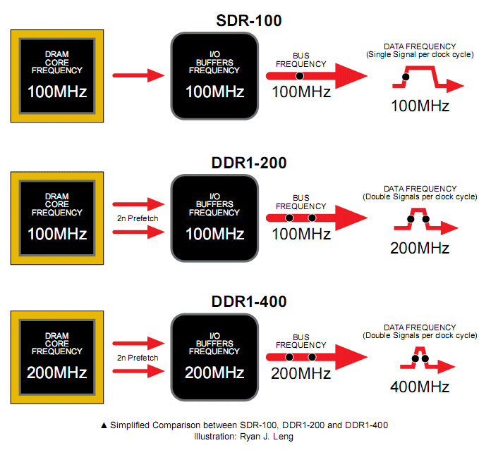
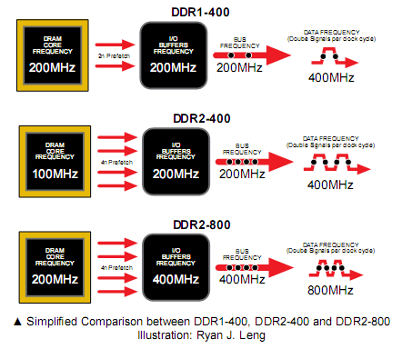
DDR (Double Data Rate) SDRAMs
DDR1 VS DDR1+:
DDR2 vs. QDR

Slide 117
DRAM Subsystem Organization
Dram: Dynamic RAM
DRAM Organization:
Chip:
Consists of multiple banks (2-16 in Synchronous DRAM)
Banks works in parallel to overlap delay
Banks share command/address/data buses
The chip itself has a narrow interface (4-16 bits per read)
Channel
DIMM
Rank
Chip
Bank
Row/Column

Slide 118
DRAM Subsystem Organization
Dram: Dynamic RAM
DRAM Organization:
Rank:
Multiple chips operated together to form a wide interface
All chips comprising a rank are controlled at the same time
Respond to a single command
Share address and command buses, but provide different data
E.g., Using 8 chips with 8-bit interface to form a 64-bit wide Rank
Channel
DIMM
Rank
Chip
Bank
Row/Column

Slide 119
DRAM Subsystem Organization
Dram: Dynamic RAM
DRAM Organization:
DIMM (dual inline memory module):
A DRAM module consists of one or more ranks
This is what you plug into your motherboard
Channel
DIMM
Rank
Chip
Bank
Row/Column

Slide 120
DIMM (Dual Inline Memory Module)
Contains DRAM chips each have data widths of x4 or x8
Can be on both sides
Can have more than one rank
Increase storage capacity
Only one rank accessible at a time
SIMM vs DIMM
DIMM has separate contacts on each side of the board to provides twice as much data rate.

Slide 121
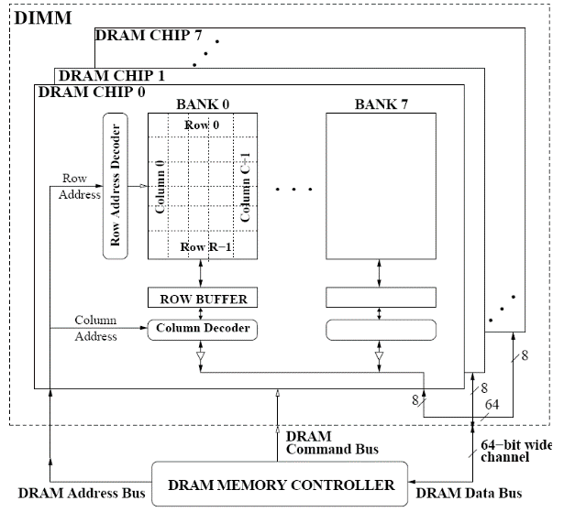
A 64-bit Wide DIMM (One Rank)
Advantages:
Acts like a high-capacity DRAM chip with a wide interface
Flexibility: memory controller does not need to deal with individual chips
Disadvantages:
Granularity: Accesses cannot be smaller than the interface width

Slide 122
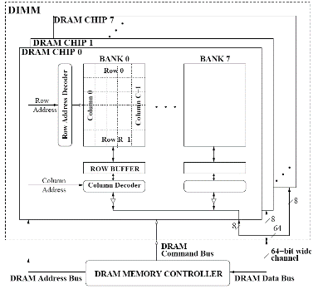
DRAM Subsystem Organization
Dram: Dynamic RAM
DRAM Organization:
Channel: Independent memory subsystem
E.g., 2 independent Channels:
Channel
DIMM
Rank
Chip
Bank
Row/Column

Slide 123
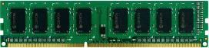
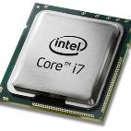
The DRAM subsystem
“Channel”
DIMM (Dual in-line memory module)
Processor
Memory channel
Memory channel
Each channel is connected to its own on-die memory controller

Slide 124
Row Operations & Row Buffer Locality
Access Address: Row Operation:
Columns
(Row 0, Column 0)
Activation
RBL=2
(Row 0, Column 1)
No operation
RBL=1
(Row 1, Column 0)
Restore, Precharge, Activation
Row address 0
Row address 1
Row decoder
R1
R0
R0
Rows
Row Buffer
CONFLICT !
Row 1
HIT
Row 0
Empty
Column address 0
Column mux
Column address 0
Column address 1
Improving Row Buffer Locality (RBL) is the key to improve DRAM efficiency
Data
Credit: Onur Mutlu.

Slide 125
RBL & Memory Scheduling Schemes
Row Buffer Locality
Visible to the memory scheduler
In-order scheduling
(FIFO):
Activation Counter:
R1: Activation = 1
R5: Activation = 2
R1: Activation = 3
R5: Activation = 4
R5: Activation = 4
Avg RBL = 5 / 4 = 1.25
future
requests
requests currently
in the pending queue
oldest
request
Same
activation
Request Stream
……
……
R4
R3
R2
R5
R5
R1
R5
R1
Out-of-order scheduling
(FR-FCFS):
Activation Counter:
R1: Activation = 1
R1: Activation = 1
R5: Activation = 2
R5: Activation = 2
R5: Activation = 2
Avg RBL = 5 / 2 = 2.5
future
requests
requests currently
in the pending queue
Same
activation
oldest
request
Same
activation
Request Stream
……
……
R4
R3
R2
R5
R5
R1
R5
R1

Slide 126
DRAM Milestones
 | DRAM | Page DRAM | Page DRAM | Page DRAM | SDRAM | DDR SDRAM
Module Width | 16b | 16b | 32b | 64b | 64b | 64b
Year | 1980 | 1983 | 1986 | 1993 | 1997 | 2000
Mb/chip | 0.06 | 0.25 | 1 | 16 | 64 | 256
Die size (mm²) | 35 | 45 | 70 | 130 | 170 | 204
Pins/chip | 16 | 16 | 18 | 20 | 54 | 66
BWidth (MB/s) | 13 | 40 | 160 | 267 | 640 | 1600
Latency (nsec) | 225 | 170 | 125 | 75 | 62 | 52
In the time that the memory to processor bandwidth has more than doubled the memory latency has improved by a factor of only 1.2 to 1.4
Patterson, CACM Vol 47, #10, 2004

Slide 127
Review: DRAM vs. SRAM
DRAM
Slower access (capacitor)
Higher density (1T 1C cell)
Lower cost
Requires refresh (power, performance, circuitry)
Manufacturing requires putting capacitor and logic together
SRAM
Faster access (no capacitor)
Lower density (6T cell)
Higher cost
No need for refresh
Manufacturing compatible with logic process (no capacitor)

Slide 128
Magnetic Disk
Track
Controller
+
Cache
Purpose: Long term, nonvolatile storage
Lowest level in the memory hierarchy: large, cheap, slow
General structure
1 to 4 rotating platter coated with a magnetic surface (2 sides recordable)
Rotational speeds of 5,400 to 15,000 RPM
Moveable read/write head to access the information for each platter
10,000 to 50,000 tracks per surface
Cylinder - all the tracks under the head at a given point on all surfaces
100 to 500 sectors per track
The smallest unit that can be read/written (typically 512B)
Outer tracks can hold more sectors than the inner tracks
Sector
Cylinder
Platter
Head

Slide 129
Magnetic Disk Characteristic
Track
Seek time: position the head over the proper track
3 to 12/15 ms on average
Due to locality of disk references, the actual average seek time may be only 25% to 33% of the advertised number
Controller
+
Cache
Sector
Cylinder
Rotational latency: wait for the desired sector to rotate under the head
½ of 1/RPM converted to ms: 0.5R/5400RPM = 5.6ms to 0.5R/15000RPM = 2.0ms
Transfer time: transfer a block of bits (one or more sectors) under the head to the disk controller’s cache (70 to 125 MB/s are typical disk transfer rates)
the disk controller’s “cache” takes advantage of spatial locality in disk accesses
cache transfer rates are much faster (e.g., 375 MB/s)
Controller time: the overhead the disk controller imposes in performing a disk I/O access (typically < 0.2 ms)
Platter
Head

Slide 130
Typical Disk Access Time
If the measured average seek time is 25% of the advertised average seek time, then
The average time to read or write a 512B sector for a disk rotating at 15,000 RPM with average seek time of 4 ms, a 100MB/sec transfer rate, and a 0.2 ms controller overhead
Avg disk read/write
= 4.0 ms + 0.5/(15,000RPM/(60sec/min)) + 0.5KB/(100MB/sec) + 0.2 ms
= 4.0 + 2.0 + 0.005 + 0.2 = 6.2 ms
Avg disk read/write = 1.0 + 2.0 + 0.005 + 0.2 = 3.2 ms

Slide 131
Disk Latency & Bandwidth Improvement
Disk latency = average seek time + rotational latency.
Disk bandwidth is the peak transfer speed of formatted data from the media (not from the cache).
Patterson, CACM Vol 47, #10, 2004

Slide 132
How is the Hierarchy Managed?
registers ↔ memory
by compiler (or programmer)
registers ↔ cache ↔ main memory
by the cache & memory controller hardware
main memory ↔ external storage (flash, disk)
Static: by the programmer with OS support (files)
Dynamic: by the operating system (virtual memory)
virtual address to physical address mapping
assisted by the hardware (TLB, page tables)

Slide 133
Virtual Memory
31 30 . . . 12 11 . . . 0
Virtual page number
Page offset
Virtual Address (VA)
Translation
Physical page number
Page offset
Physical Address (PA)
29 . . . 12 11 0
A virtual address must first be translated to a physical address to access memory
Basic unit: page (e.g., 1KB to 64KB)
Virtual memory size can be larger than physical memory size
Pages can be stored in the secondary storage

Slide 134
Address Space Isolation
Allows efficient and safe sharing of main memory among multiple processes
The starting location of each page is contained in the program’s page table
Create the illusion that each program has a large consecutive memory space
Improving memory utilization: code can be loaded anywhere the OS can find space
Program 1 page table
Main (physical) memory
Virtual address space
Program 2 page table

Slide 135
Address Translation Mechanisms
Virtual page #
Offset
virtual address
Physical page #
physical address
Offset
Physical page
base addr
Main memory
V
1
1
1
1
1
1
0
1
0
1
0
Page table register
Page fault: a DRAM miss for the page
→ Page in disk
Page walk: Search (walk) the page table
Disk storage
Page Table (in main memory)

Slide 136
Virtual Addressing with a Cache
It takes an extra memory access to translate a VA to a PA
VA
PA
miss
Trans-
lation
Cache
Main
Memory
CPU
hit
data
This makes memory (cache) accesses very expensive
The hardware solution is to use a Translation Lookaside Buffer (TLB)
A small cache that keeps track of recently used address mappings to avoid having to do a page table lookup in main memory

Slide 137
Making Address Translation Fast
Virtual page #
Physical page
base address
V
Tag
1
1
1
0
1
TLB
Main memory
Physical page
base address
V
1
1
1
1
1
1
0
1
0
1
0
Page table register
Disk storage
Page Table (in physical memory)

Slide 138
A TLB in the Memory Hierarchy
¼ t
hit
¾ t
A TLB miss – is it a page fault or merely a TLB miss?
If the page is loaded into main memory, then the TLB miss can be handled by loading the translation information from the page table into the TLB (10’s of cycles )
If the page is not in main memory, then it’s a true page fault (1,000,000’s)
TLB misses are much more frequent than true page faults
VA
PA
miss
TLB
Lookup
Cache
Main
Memory
CPU
miss
hit
Trans-
lation
data

Slide 139
TLB Event Combinations
TLB | Page Table | Cache | Possible? Under what circumstances?
Hit | Hit | Hit
Hit | Hit | Miss
Miss | Hit | Hit
Miss | Hit | Miss
Miss | Miss | Miss
Hit | Miss | Miss/ Hit
Miss | Miss | Hit
Yes – this is what we want!
Yes – although the page table is not
checked after the TLB hits
Yes – TLB missed, but PA is in page table and data is in cache
Yes – TLB missed, but PA is in page table, data not in cache
Yes – page fault
No – TLB translation is not possible if the page is not present in main memory
No – data is not allowed in the cache if the
page is not in memory

